Slide 1
Deployment and Operations for Software Engineers 2nd Ed
Chapter 4 – The Cloud

Slide 2
Outline
Structure
Service models
Failure
Scaling
State management
Sharing distributed data
Security policies

Slide 3
Cloud characteristics
A public cloud is available over the internet to anyone who can pay for what they use.
A private cloud is owned by a single organization and usage is restricted to members of that organization.
The public cloud has several characteristics
You pay only for what you use.
The storage and computation services are elastic, meaning that it can grow or shrink as your needs change.
Your use of the cloud is self-provisioned: You create an account and can immediately begin using it.

Slide 4
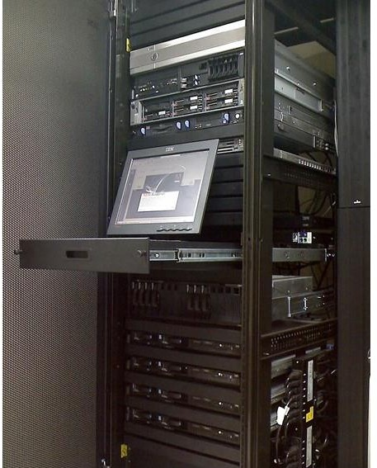
Data center
Contains 50,000+ computers
Independent power supply, security, air conditioning, etc.
Computers are stored in racks.
Computers are, mostly, commodity.

Slide 5
Hierarchical data center collections
Multiple geographically related data centers comprise an availability zone.
Multiple availability zones compromise a region.
Cloud providers maintain multiple regions around the globe.
North America
South America
Europe
Asia-Pacific
South Africa

Slide 6
Allocating new VM in cloud
You request a VM and specify
Region
Availability zone
Type of VM
VM image
Security settings
Other parameters.
Cloud provider finds physical computer with spare capacity in the specified availability zone in the specified region.
Hypervisor in that physical computer creates new VM, loads image, and returns IP address.

Slide 7
Discussion questions
What region are you in for AWS, Google, and Azure? How many availability zones for each provider in your region.
Why are commodity computers used in cloud providers data centers?
What are parameters in addition to the ones listed must be specified to allocate a VM?

Slide 8
Outline
Structure
Service models
Failure
Scaling
State management
Sharing distributed data
Security policies

Slide 9
Service Models
Infrastructure as a Service (IaaS).
Platform as a Service (PaaS).
Software as a Service (SaaS). Also called “hosted services”, Total applications or servciesavailable from cloud providers such as email, customer management, invoicing, etc.

Slide 10
IaaS
Provides CPUs, storage, and networks.
Useful to move systems, as is, to the cloud with no rearchitecting.

Slide 11
PaaS
Complete cloud environment that includes everything developers need to build, run, and manage applications—from servers and operating systems to all the networking, storage, middleware, and tools.
Useful when developing a system from scratch.
Libraries can include
Monitoring
Security
Storage
Databases

Slide 12
SaaS
Also called “hosted”
Provides systems rather than components
Examples
Gmail
Dropbox
Zoom
…

Slide 13
Outline
Structure
Service models
Failure
Scaling
State management
Sharing distributed data
Security policies

Slide 14
Sometimes the whole cloud fails
Search for “cloud outages” to get enumerations of cloud failures
Outages affect all major cloud providers.

Slide 15
And sometimes just a part of it fails …

Slide 16
A year in the life of a Google datacenter
~0.5 overheating (power down most machines in <5 mins, ~1-2 days to recover)
~1 PDU failure (~500-1000 machines suddenly disappear, ~6 hours to come back)
~20 rack failures (40-80 machines instantly disappear, 1-6 hours to get back)
~5 racks go wonky (40-80 machines see 50% packetloss)
~8 network maintenances (4 might cause ~30-minute random connectivity losses)
~12 router reloads (takes out DNS and external vips for a couple minutes)
~3 router failures (have to immediately pull traffic for an hour)
~dozens of minor 30-second blips for dns
~1000 individual machine failures
~thousands of hard drive failures
slow disks, bad memory, misconfigured machines, flaky machines, dead horses,

Slide 17
Amazon failure statistics
In a data center with ~64,000 servers, each with two disks
On a typical day
~5 servers fail
~17 disks fail

Slide 18
Normal distribution

Slide 19
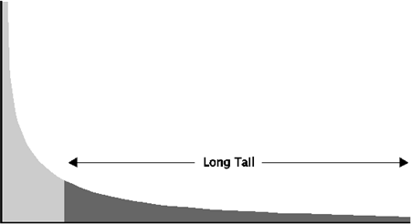
Long Tail distribution
In a long tail distribution, some values are far from the median.
These values are sufficient to influence the mean.
The mean and the median are dramatically different.

Slide 20
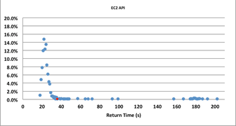
What does this mean?
If there is a partial failure of the cloud some activities will take a long time to complete and exhibit a long tail.
The figure shows distribution of 1000 AWS “launch instance” calls.
4.5% of calls were
“long tail”

Slide 21
You must be aware of the possibility of a long tail distribution
Long tail latencies are a result of congestion or failure somewhere in the path of the service request.
There are many possible contributors to congestion–server queues, hypervisor scheduling, or others–but the cause of the congestion is out of your control as a service developer.
Your monitoring techniques and your programming techniques must reflect the possibility of a long tail distribution.

Slide 22
Discussion questions
Has there been a cloud outage in your region recently? What was the cause?
The Google failure statistics talk about a “rack failure”. What is a rack failure?

Slide 23
Outline
Structure
Service models
Failure
Scaling
State management
Sharing distributed data
Security policies

Slide 24
Load balancer
One server may not suffice for all of the requests for a given service.
Have multiple servers supplying the same service.
Use “load balancer” to distribute requests.
Server is registered with load balancer upon initialization
Load balancer monitors health of servers and knows which ones are healthy.
All servers managed by one load balancer are identical
Load balancer IP is returned from DNS server when client requests URL of service.

Slide 25














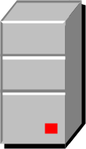
Client sends message
Clients
Gateway
Load Balancer
Servers

Slide 26
Message goes to gateway
Clients
Gateway
Load Balancer
Servers

Slide 27
Message goes to load balancer
Clients
Gateway
Load Balancer
Servers

Slide 28
Message goes to server
Clients
Gateway
Load Balancer
Servers

Slide 29
Reply goes to gateway
Clients
Gateway
Load Balancer
Servers

Slide 30
Reply goes to client
Clients
Gateway
Load Balancer
Servers

Slide 31
Note IP manipulation
Client sends message to load balancer.
Gateway intercepts message and changes source to be its IP
Gateway sends message to load balancer
Load balancer changes destination to be a server.
Load balancer changes destination IP but not the source.
Server always sends message back to what it thinks is the source. In this example, it is the gateway. The reply goes directly back to gateway.
Gateway sends reply to client.

Slide 32
Routing algorithms
Load balancers use variety of algorithms to choose instance for message
Round robin. Rotate requests evenly
Weighted round robin. Rotate requests according to some weighting.
Hash IP address of source to determine instance. Means that a request from a particular client always sent to same instance. This is not recommended.
Note that these algorithms do not require knowledge of an instance’s load.

Slide 33
Suppose servers are overloaded
As load grows, existing resources may not be sufficient.
Autoscaling is a mechanism for creating new instances of a server.
Set up a collection of rules that determine
Under what conditions are new servers added
Under what conditions are servers deleted

Slide 34




First there were three servers
Load Balancer
Servers

Slide 35




Now there are four
Issues:
What makes the decision to add a new server?
How does the new server get loaded with software?
How does the load balancer know about the new server?

Slide 36

Making the decision
autoscaler
Each server reports its CPU and I/O usage to an autoscaler
Autoscaler has a collection of rules to determine whether to add new server. E.g. one server is over 80% utilization for 15 minutes

Slide 37


Loading the new server with software
When a new instance is created, it is created based on a launch configuration, security groups, etc
Configuration specification

Slide 38



Making the load balancer new server aware
The new server is registered with a load balancer by the autoscaler

Slide 39
Managing instance failure
Replies from server may not go through load balancer.
It must have another mechanism to determine health of servers.
Each server sends a “I am alive” message periodically.
This tells load balancer the server is healthy.
If the server is unhealthy, the load balancer will not send it any more messages.
If the server fails, the autoscaler will detect failure and create new instance, depending on its rules.

Slide 40
Discussion questions
Why is not recommended to use hashing as a load balancer distribution algorithm?
How does autoscaler know the launch configuration to load new server with software?
Suppose load balancer fails. How is that handled?
Suppose autoscaler fails. How is that handled?

Slide 41
Outline
Structure
Service models
Failure
Scaling
State management
Sharing distributed data
Security policies

Slide 42
How state is managed is important
For both performance and logical reasons.

Slide 43
Performance numbers
Transferring data times:
Read 1,000,000 bytes from memory 47 μsec
Round trip in same data center ~500 μsec
Read 1,000,000 bytes from SSD ~784 μsec
Read 1,000,000 bytes from disk ~10msec
Packet round trip Calif <-> Netherlands 150 msec
Storing state in memory is faster than storing it on disk
Sending state to same data center is faster than disk
Sending state across data centers is relatively slow.

Slide 44
Logical consequences of state management
Assume two clients and two instances of a server.
Goal is to count number of requests from clients to servers.
Three options:
Store count in clients
Store count in servers
Store count on database
Option 1 counts how many times each client calls any server
Option 2 counts how many times each server is called
Option 3 counts how many calls were made by both clients together.

Slide 45
Discussion questions
Code the three options in counting example and verify results are correct.
Time message round trip in same data center. Is the number given correct?

Slide 46
Outline
Structure
Service models
FailureF
Scaling
State management
Sharing distributed data
Security policies

Slide 47
Sharing data
Many services in a distributed system want to share data with each other.
Use cases:
Locks
Configuration information
Discovery
Sequencing tasks
…

Slide 48
Options for sharing data
Persistent database.
Takes time. See Performance numbers on State Management slide.
Suitable for large data sets.
Distributed caching system such as Memcached., Reddis, or Elasticsearch
In memory and fast.
Suitable for small data sets
Failure will cause data loss.
42

Slide 49
Options for sharing data
Distributed coordination systems
In memory and fast
Suitable for small data sets
High availability
42

Slide 50
Memcached
Key value store
Limited to 1Mbyte
Multiple servers that do not communicate with each other.
Each client stores data in a server
Data is not shared across servers.
Clients with which data is shared must access same server
Use cases
Session data
Web page caching
API caching
Caching of objects such as images, files, and metadata

Slide 51
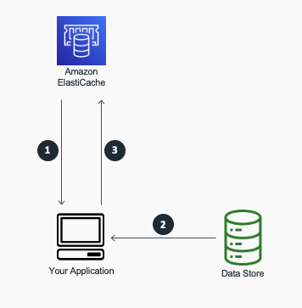
Cache-aside pattern
A read from a database first checks cache

Slide 52
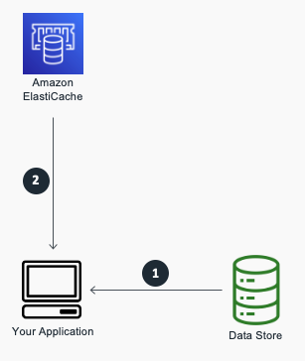
Write through caching pattern
Cache is updated after data written to database.
Used when cache aside gets a miss

Slide 53
Distributed coordination system
Fault tolerant with high availability
Manages coordination among clients.
Operations appear atomic
Multiple open source implementations
Zookeeper
etcd
Consul
Use cases
Distributed locks
Service discovery
Health checks

Slide 54
Locks
We will use locks to understand more about distributed coordination systems.
Locks give the appearance of atomicity to clients.
Critical resources are locked to prevent race conditions.
A lock is a software construct.
Associated with each resource a lock bit.
If bit is 0, no lock on resource
If bit is 1, resource is locked
In practice, locks have other information in addition to lock bit.

Slide 55
Problems with locks
Can lead to deadlock – two processes waiting for each other to release critical resources
Process one gets a lock on row 1 of a data base
Process two gets a lock on row 2.
Process one waits for process 2 to release its lock on row 2
Process two waits for process 1 to release its lock on row 1
No progress.

Slide 56
More problems with locks
Getting a lock across distributed systems is not an atomic operation.
It is possible that while requesting a lock another process can acquire the lock. This can go on for a long time (it is called livelock if there is no possibility of ever acquiring a lock)
Suppose the virtual machine holding the lock fails. Then the owner of the lock can never release it.

Slide 57
Locks in a distributed system
Utilizing locks in a distributed system has a more fundamental problem.
It takes time to send a message (create a lock, for example) from one computer to another.

Slide 58
Synchronizing data
The general problem is that you want to manage synchronization of data across a distributed set of servers where up to half of the servers can fail.
Paxos is a family of algorithms that use consensus to manage concurrency. Complicated and difficult to implement.
.

Slide 59
Synchronizing data
An example of the implementation difficulty
Choose one server as the leader which keeps the “authoritative”state.
Now that server fails. Need to
Find a new leader
Make sure it is up to date with the authoritative state.

Slide 60
Zookeeper as an example
Zookeeper provides a guaranteed consistent (mostly) data structure for every instance of a distributed system.
Definition of “mostly” is within eventual consistency lag (but this is small).
Zookeeper keeps data in memory. This is why it is fast.
Limited to 1 Mbyte
Zookeeper deals with managing failure as well as consistency.
Done using consensus algorithm.

Slide 61
Zookeeper API
All calls return atomic views of state – either succeed or fail. No partial state returned. Writes also are atomic. Either succeed or fail. If they fail, no side effects.
Function | Type
Create | Write
Delete | Write
Exists | Write
Get children | Read
Get data | Read
Set data | Write

Slide 62
Lock creation
Locks have names.
Client N
Create Lock 1
If success then client owns lock.
If failure, then it is placed on waitlist for lock 1 and control is returned to Client N
When owner of Lock 1 finishes, it deletes Lock1
If there is a waitlist, then those clients are informed about Lock 1 deletion and they try again to create Lock 1
If Client N fails, Zookeeper will delete Lock 1 and waitlist clients are informed of deletion

Slide 63
Discussion questions
How does Zookeeper check the health of its clients?
What happens if one of the servers (not the leader) in Zookeeper fails?
Compare Memcached and Redis.

Slide 64
Outline
Structure
Service models
Failure
Scaling
State management
Sharing distributed data
Security policies

Slide 65
Security policies
A security policy is a set of rules that govern which accounts or services have access to which resources.
Three aspects to rules
Identify - Authenticate users
Access - Authorize users to allow/disallow access
Visibility into actions. Ensure that actions can be traced after the fact.
These are discussed in more detail in subsequent lectures.

Slide 66
IAM
The cloud service that provides access control is called Identity and Access Management (IAM).
IAM rules are checked by invoking the IAM service when an API call is made to a cloud service.
Amazon reports over 400 million IAM calls per second.

Slide 67
Discussion questions
Many cloud users do not use IAM services. Why not?
How does a client identify itself to an IAM service?

Slide 68
END OF CHAPTER 4

